Slide 1
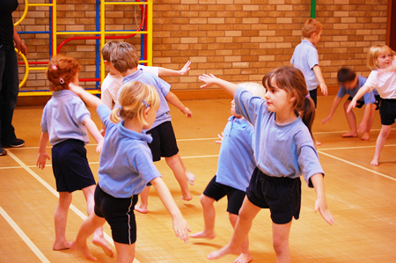
Why Do We Need to Incorporate Movement Into Our Lessons?

Slide 2
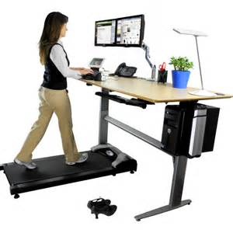
How and Why Do Need Movement in Our Lives?
As adults, we adjust our positions and naturally take breaks in which we rest and move.
We have learnt:
Our levels of need for movement
How to respond to sensation and
How to adjust the environment to enable us to function.
As an adult we are usually SELF REGULATE.
To test, why not monitor your movements within an hour, even an hour when you are sitting still to do a task. See how you might stretch, break or move naturally when you are finding it more difficult to concentrate.
Also monitor your reactions to any sensory stimuli e.g. noise and whether these are affecting your ability to do a task. What do you do so you can accommodate or filter out any sensory stimuli?

Slide 3
How and Why Do Need Movement in Our Lives?
Can anyone sit still for 10 minutes without needing to adjust position? This can vary. Some people need more movement and find it hard to sit still for longer.
Could any adult sit and read a book in a busy supermarket or cope with noise and a range of smells in a lunch hall? Some might, some might not. It depends on their own sensory profile, but they are more likely to have learnt to self regulate than children.

Slide 4
How and Why Do Need Movement in Our Lives?
As adults we are more likely to innately know what to do to support our physical and sensory systems, without thinking, to enable us to complete tasks.
However, we may expect pupils to do tasks like these and more.
What do you as a teacher do that involves movement throughout the day? Do you walk around the room while teaching expecting pupils to sit and listen?
Expectations of children are high yet they may not have developed this ability yet!

Slide 5
Why do we need to use movement and sensory experiences in lessons?
Supporting development
Enabling development of skills
Motivating pupils to learn
Enabling ability to learn

Slide 6
Why Do We Need to Use Movement and Sensory Experiences in Lessons for ALL Children?
All children can consolidate learning better through movement and sensory experiences than just visual and auditory ways of giving information. This is particularly the case for kinaesthetic learners and those with additional needs such as those with autism and sensory processing disorders.
Movement provides essential sensory feedback which can calm or alert sensory systems and therefore support a child to be prepared for different activities better
This may seem like additional work but if it becomes part of the school day, it doesn’t have to be.
Activities can be completed as a whole class – movement breaks, fine motor skills and attention and learning activities can become part of subject delivery.

Slide 7
Why do we need to use movement and sensory experiences in lessons for particular children?
Every teacher in every class in every school has pupils with physical and sensory issues which impact their ability to access the curriculum and learn to their potential.
There are number of areas a child could be experiencing difficulties in.
Activities suggested in this section can cover a range of needs.
Children who have difficulties with developing movement based skills or sensory processing will be struggling in relation to their peers.
By incorporating whole class movement breaks and activities this will increase inclusion, help develop self-esteem and if required help identify the need for referral to appropriate services for additional support.

Slide 8
Why do we need to use movement and sensory experiences in lessons for particular children?
Different children may need different physical and sensory experiences to support different types of learning. Some children may need to spin to be ready to read for example. This may be necessary to awake the sensory system for learning. Other children will need calming movement to bring them down to the level of appropriate concentration ability to learn.
Incorporating movement and sensory activities will allow you to not just be the detective, but the enabler! For those children where their needs are less disabling, these activities can help to bring them along and develop.

